Slide 1

Corona Virus Analysis with SQL
Mentorness
Internship Project by
Aiman Parvaiz
Batch: MIP-DA-07

Slide 2
Content
Project Overview
Dataset Description
Analysis (Queries)
Summary

Slide 3
Project Overview 1. The CORONA VIRUS pandemic has had a significant impact on public health and has created an urgent need for data-driven insights to understand the spread of the virus. 2. As a data analyst, you have been tasked with analyzing a CORONA VIRUS dataset to derive meaningful insights and present your findings.

Slide 4
Dataset: Description of each column in dataset: Province: Geographic subdivision within a country/region. Country/Region: Geographic entity where data is recorded. Latitude: North-south position on Earth's surface. Longitude: East-west position on Earth's surface. Date: Recorded date of CORONA VIRUS data. Confirmed: Number of diagnosed CORONA VIRUS cases. Deaths: Number of CORONA VIRUS related deaths. Recovered: Number of recovered CORONA VIRUS cases.

Slide 5
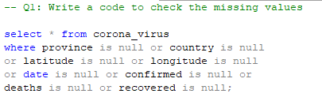
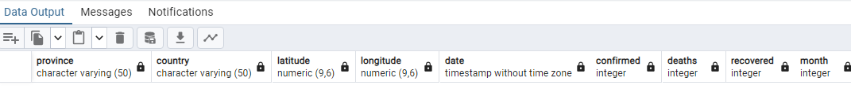
Queries Analysis Query-1

Slide 6
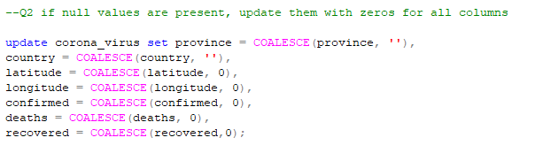
Queries Analysis Query-2

Slide 7

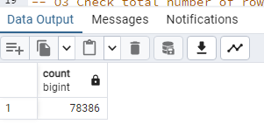
Queries Analysis Query-3

Slide 8
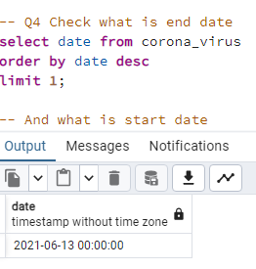
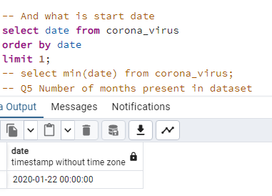
Queries Analysis Query-4

Slide 9
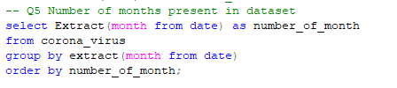
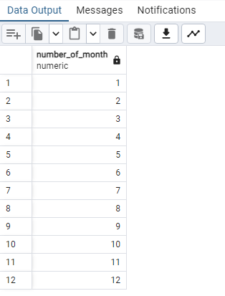
Queries Analysis Query-5

Slide 10
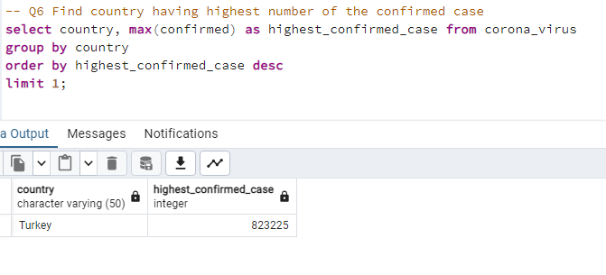
Queries Analysis Query-6

Slide 11

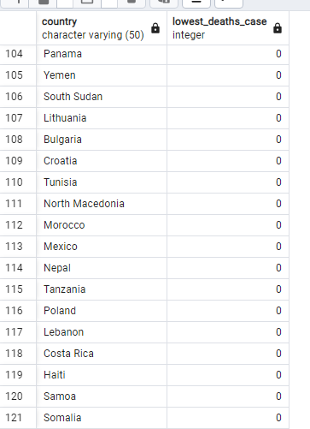
Queries Analysis Query-7

Slide 12
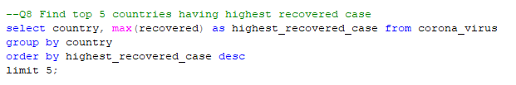
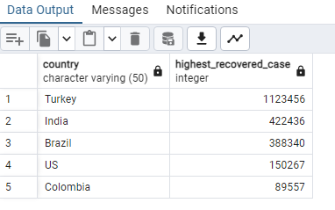
Queries Analysis Query-8

Slide 13
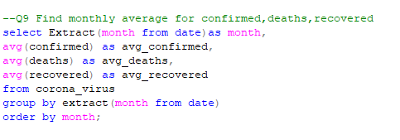
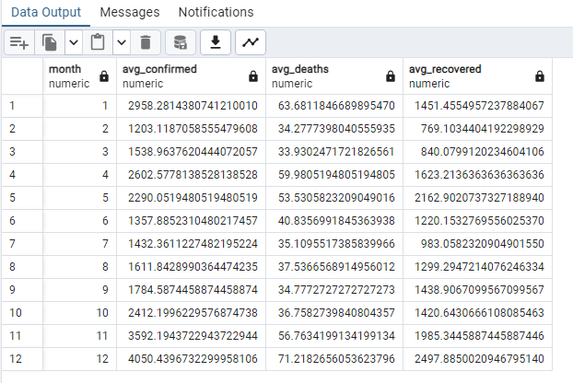
Queries Analysis Query-9

Slide 14
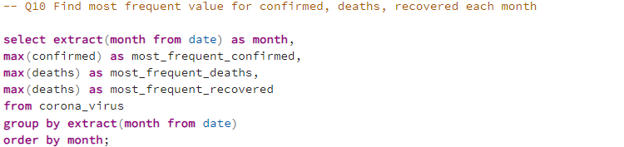
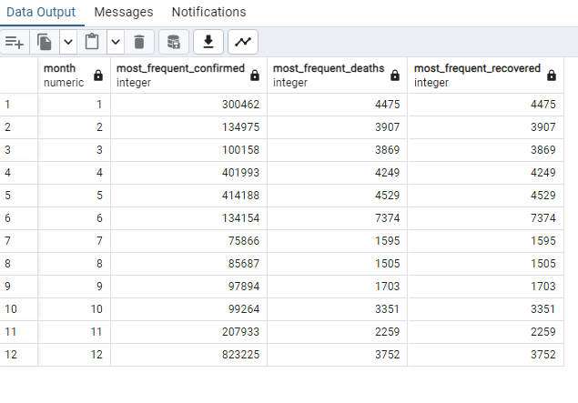
Queries Analysis Query-10

Slide 15
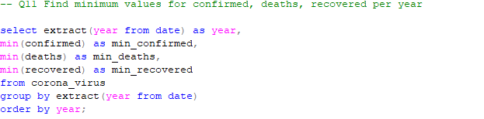
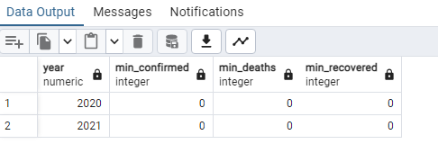
Queries Analysis Query-11

Slide 16
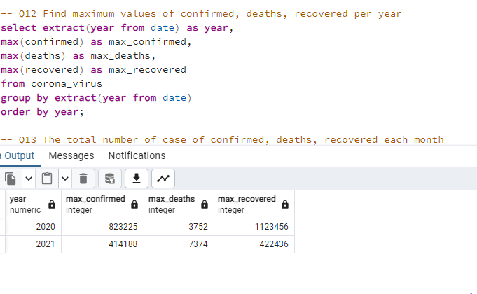
Queries Analysis Query-12

Slide 17
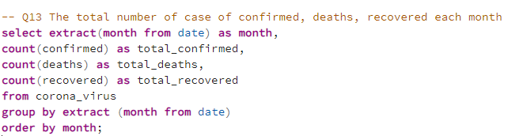
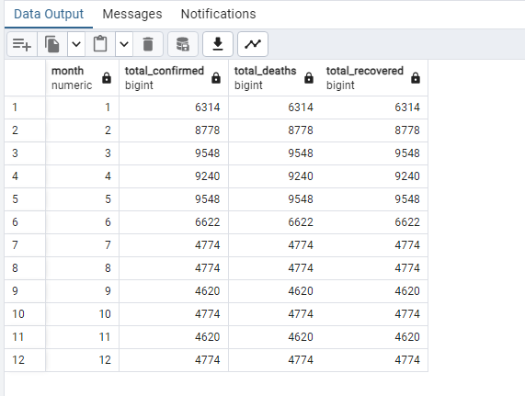
Queries Analysis Query-13

Slide 18
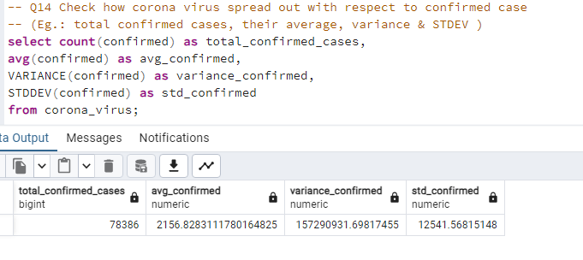
Queries Analysis Query-14

Slide 19
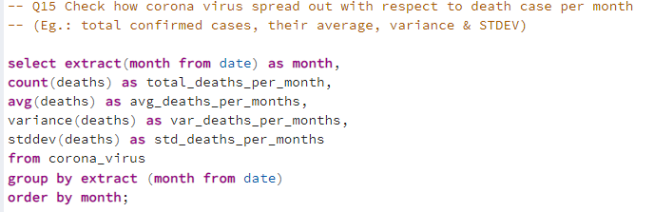
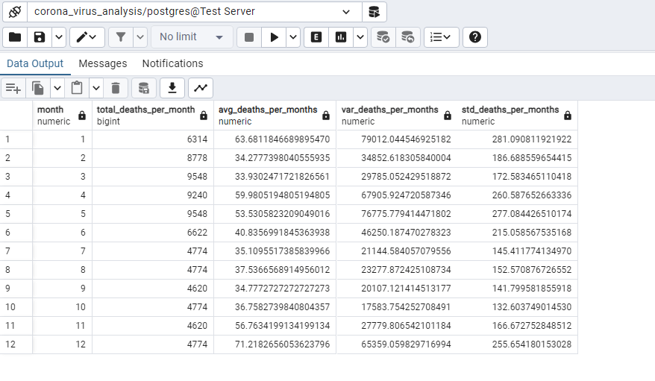
Queries Analysis Query-15

Slide 20
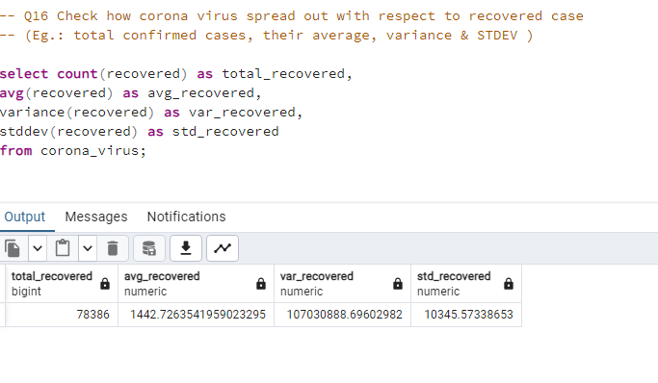
Queries Analysis Query-16

Slide 21
Summary Data Gathering: First, we collect data from various sources like hospitals, health departments, and research institutes. This includes information on confirmed cases, deaths, recoveries, and demographic details. Data Cleaning: Next, we clean the data to remove any inconsistencies, errors, or missing values. This ensures that our analysis is based on accurate information. Exploratory Analysis: We use SQL queries to explore the data, looking for patterns, trends, and correlations. This helps us understand how the virus is spreading, which regions are most affected, and how different factors like age and gender influence outcomes. Aggregation: We aggregate the data to summarize key metrics such as total cases, deaths, and recovery rates for different countries, regions, and time periods. This allows us to compare the impact of the virus across different areas and track its progression over time.

Slide 22
Thank You

